Slide 1
EVENT BOOKING SYSTEM
NAME: BAREDDY RAJA SHEKHAR REDDY
REGISTRATION NUMBER: 11908537
ROLL NUMBER: A16
SECTION:KM002

Slide 2
TECHNOLOGIES USED:
PHP
LARAVEL,BLADE
BOOTSTRAP
JAVASCRIPT
CSS
SQL

Slide 3

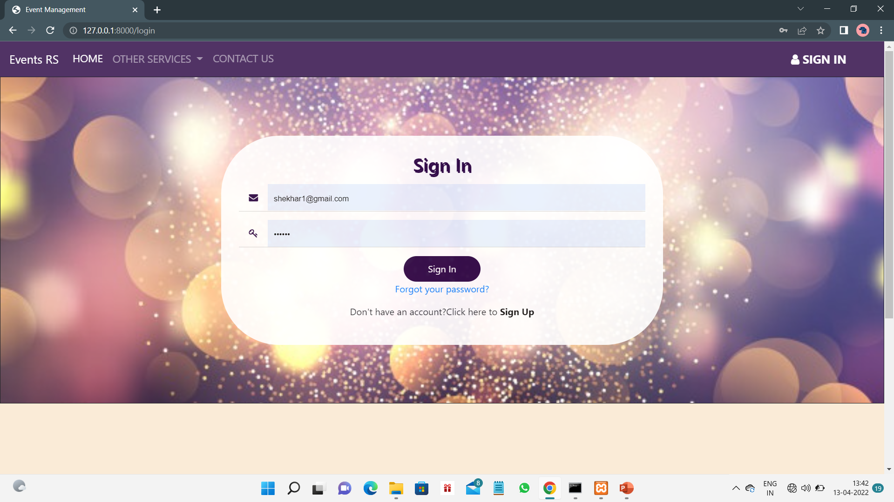
LOGIN AND SIGNUP PAGE FOR USER
Here the customer need to sign in through his account details and if the customer is new to the site. He needs to sign up first and then login.
These are the snapshots for login page and sing up page

Slide 4
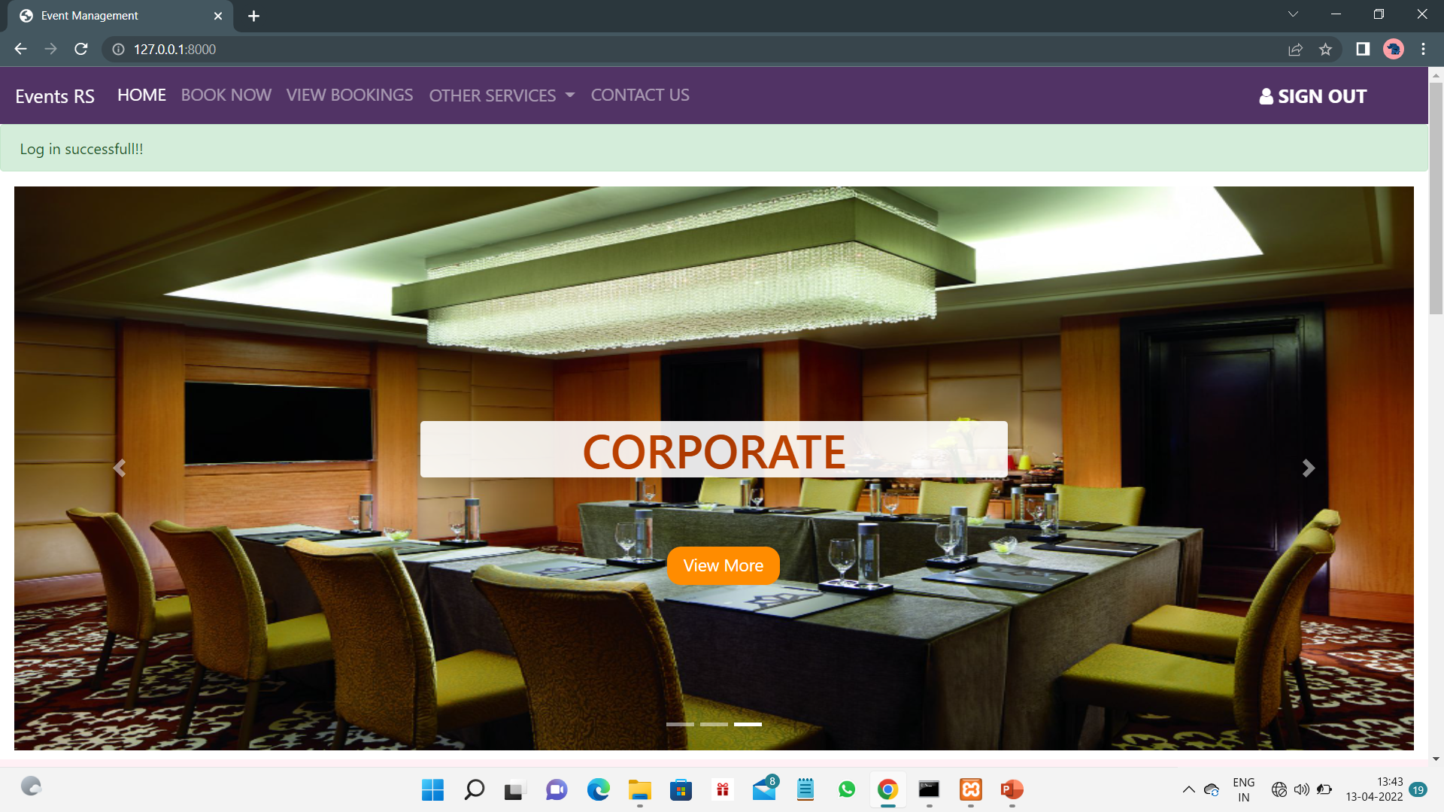
INDEX PAGE
This is the index page after login as a user or customer .
Here the customer can able to book the venue at specific time and also can view his booking.
He can also have other services like band and decoration.

Slide 5
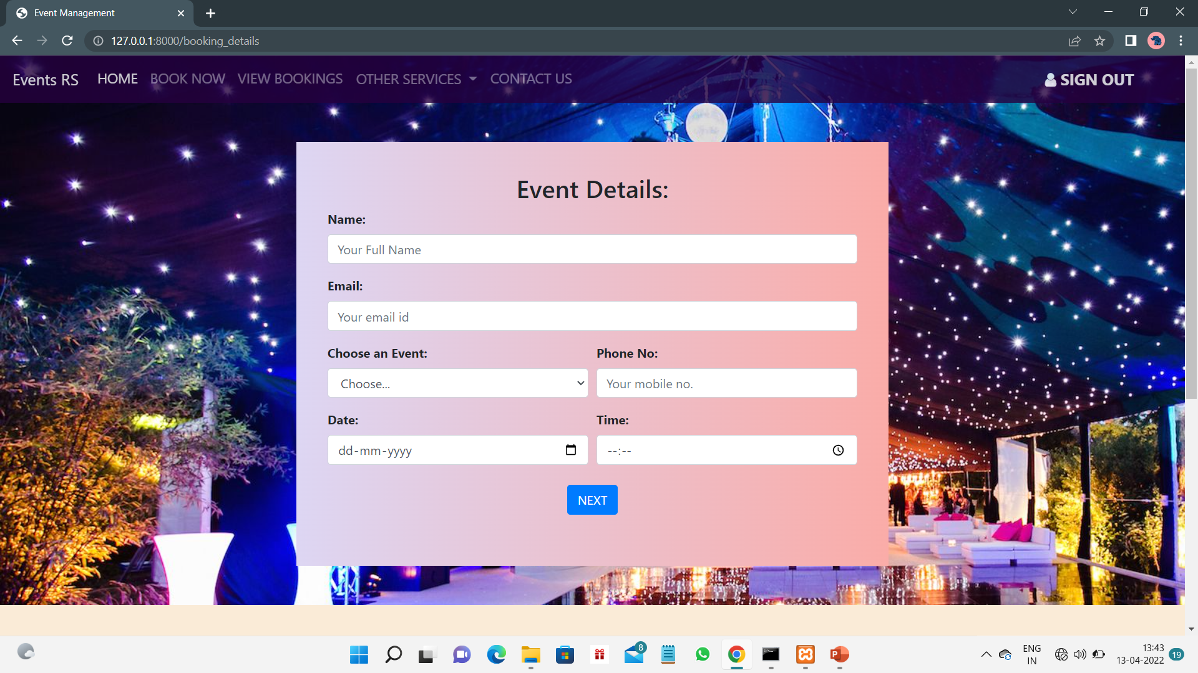
EVENT DETAILS AND BOOKING PROCESS
In the book now section, the customer can book his event by providing the personal details date and time of the event
In the next , he can select the venue can give the no.of guests would be there at the event.

Slide 6
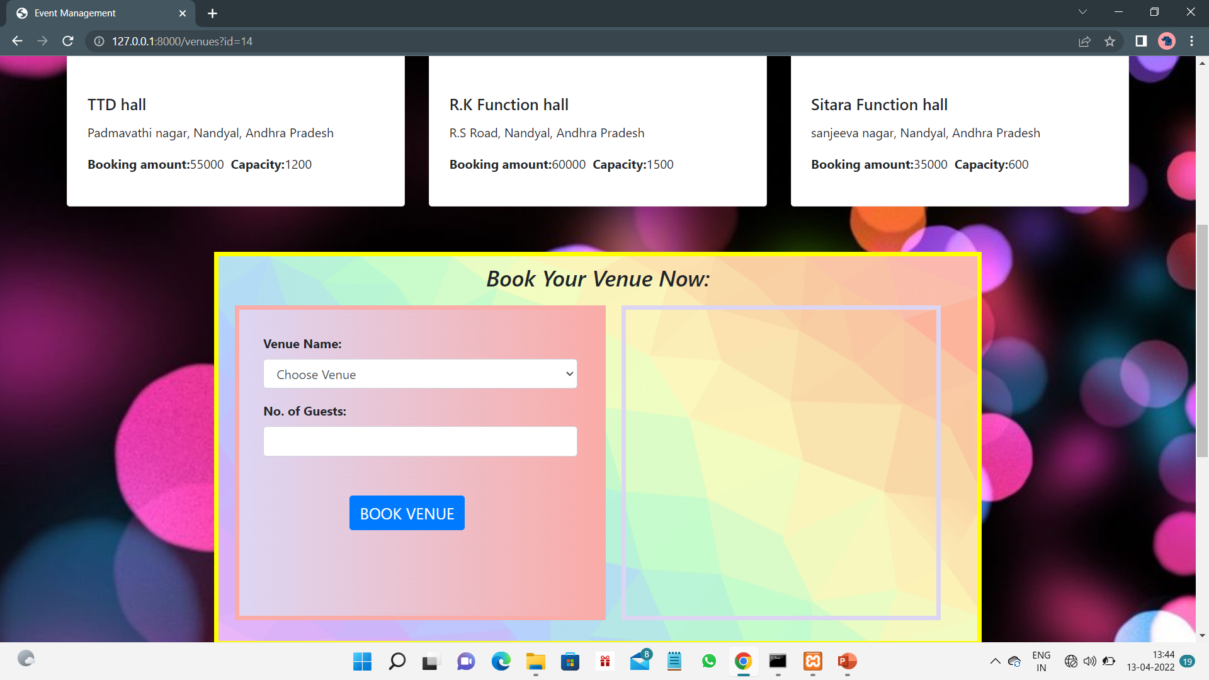
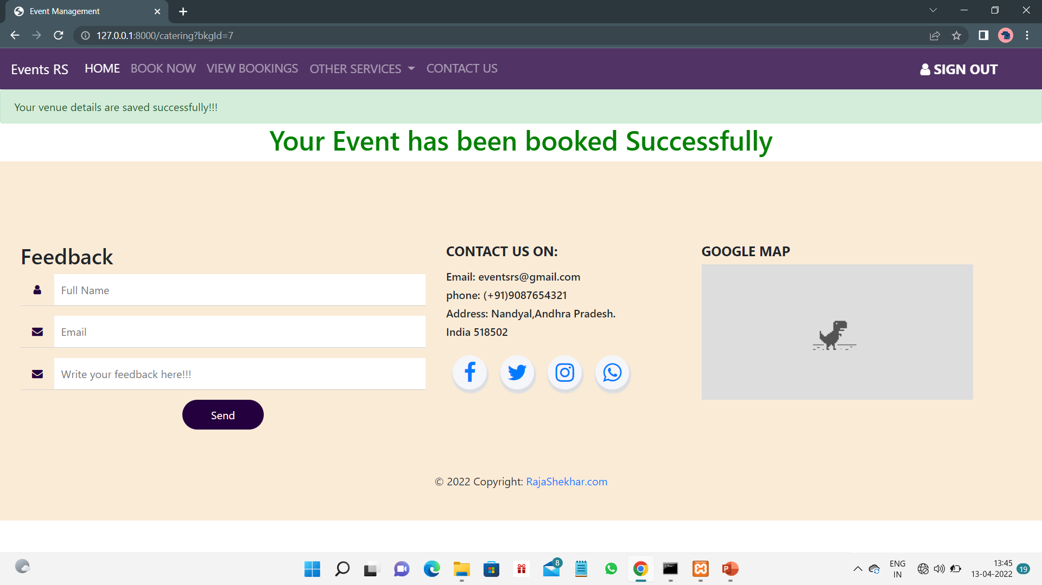
VENUE BOOKING AND CONFIRMATION

Slide 7
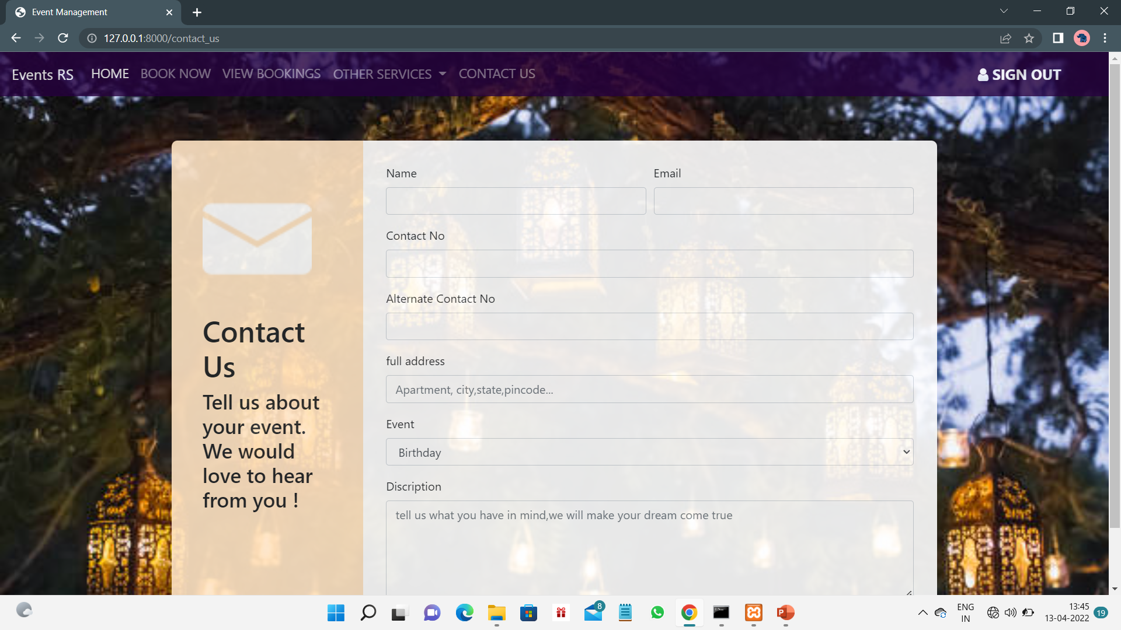
CONTACT US PAGE
There is an option “contact us”. When customer faces any inconvenience with the website. He/she can contact us, by just mentioning the text in the contact us page with the help of his/her details.

Slide 8
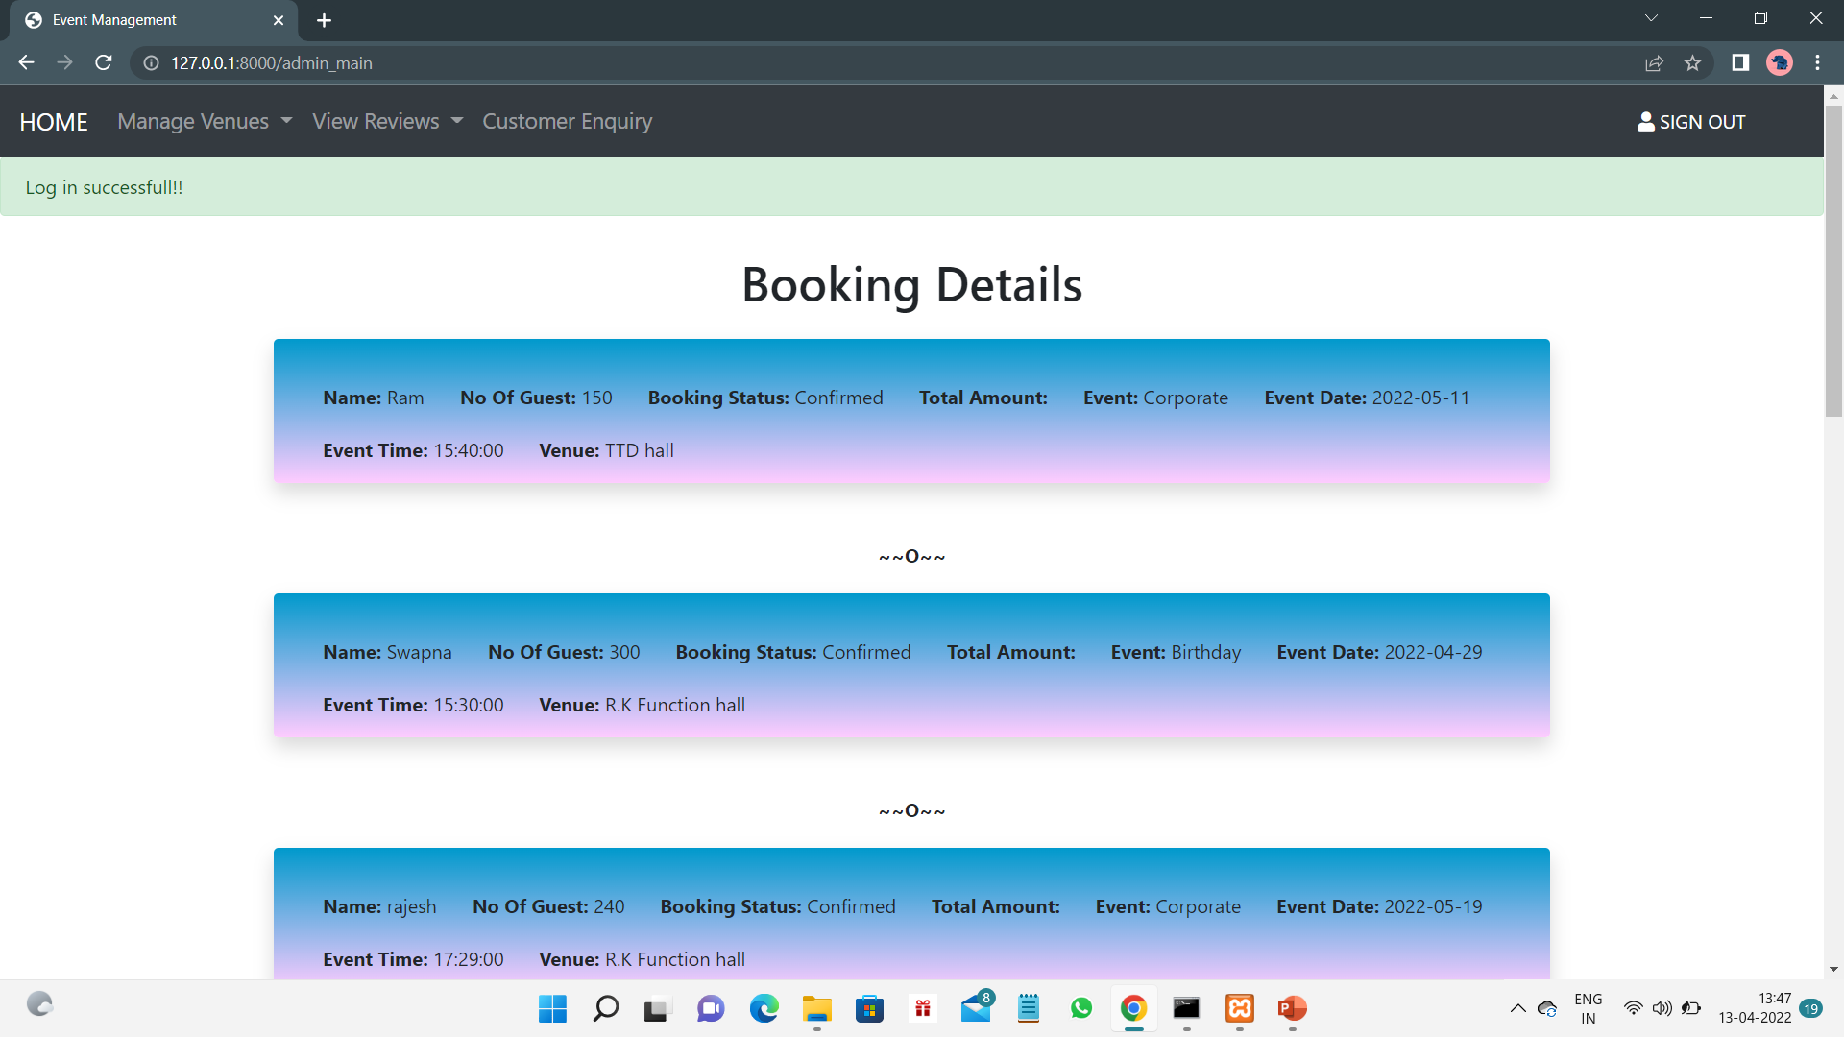
ADMIN DASHBOARD
Here comes the admi part, admin has an access to the bookings made by the customer, adding and removing the venue, feedback, reviews and enquiry details
Here the admin can confirm booking and can also reject the booking if the time slot is not free.

Slide 9
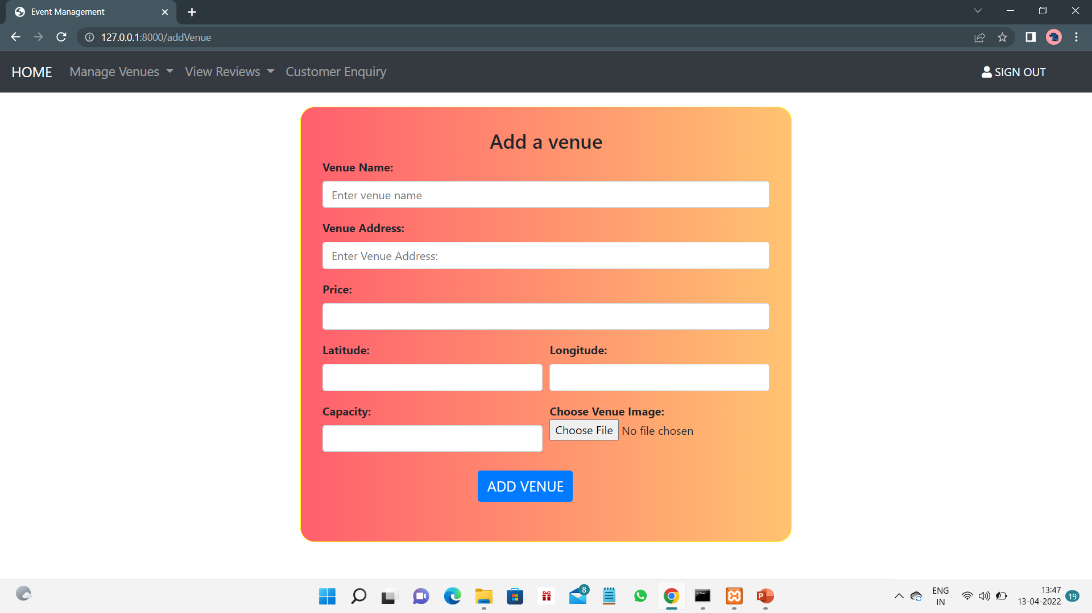
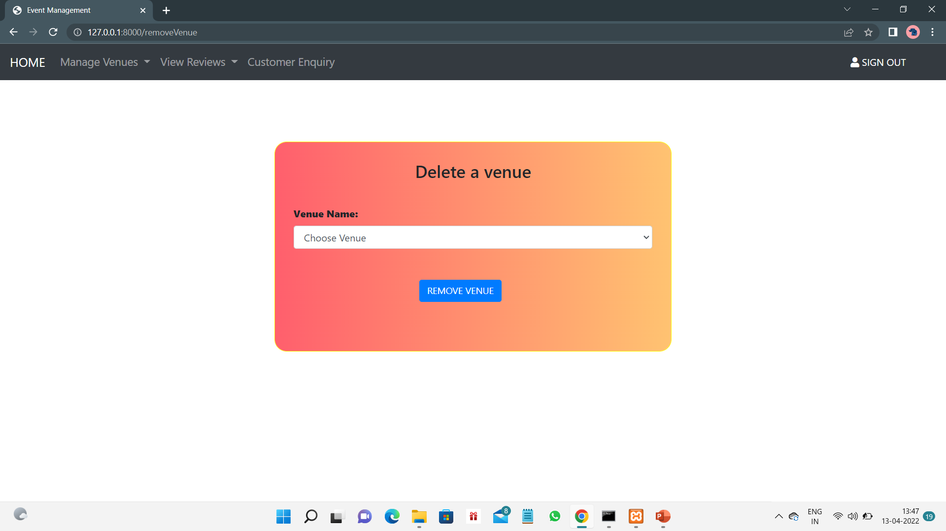
ADDING AND DELETING THE VENUE

Slide 10
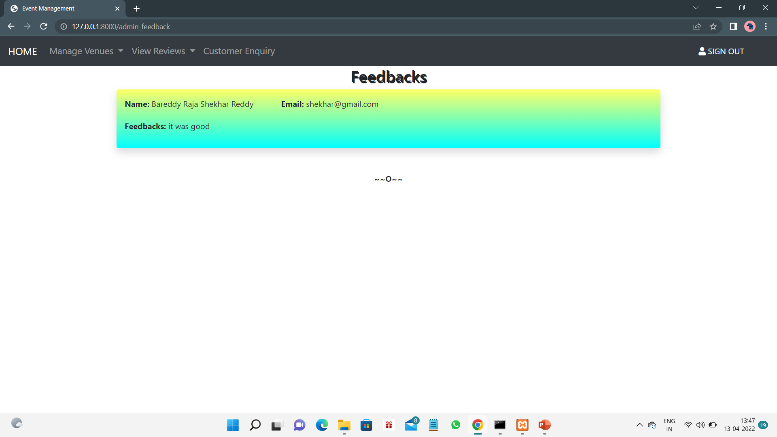
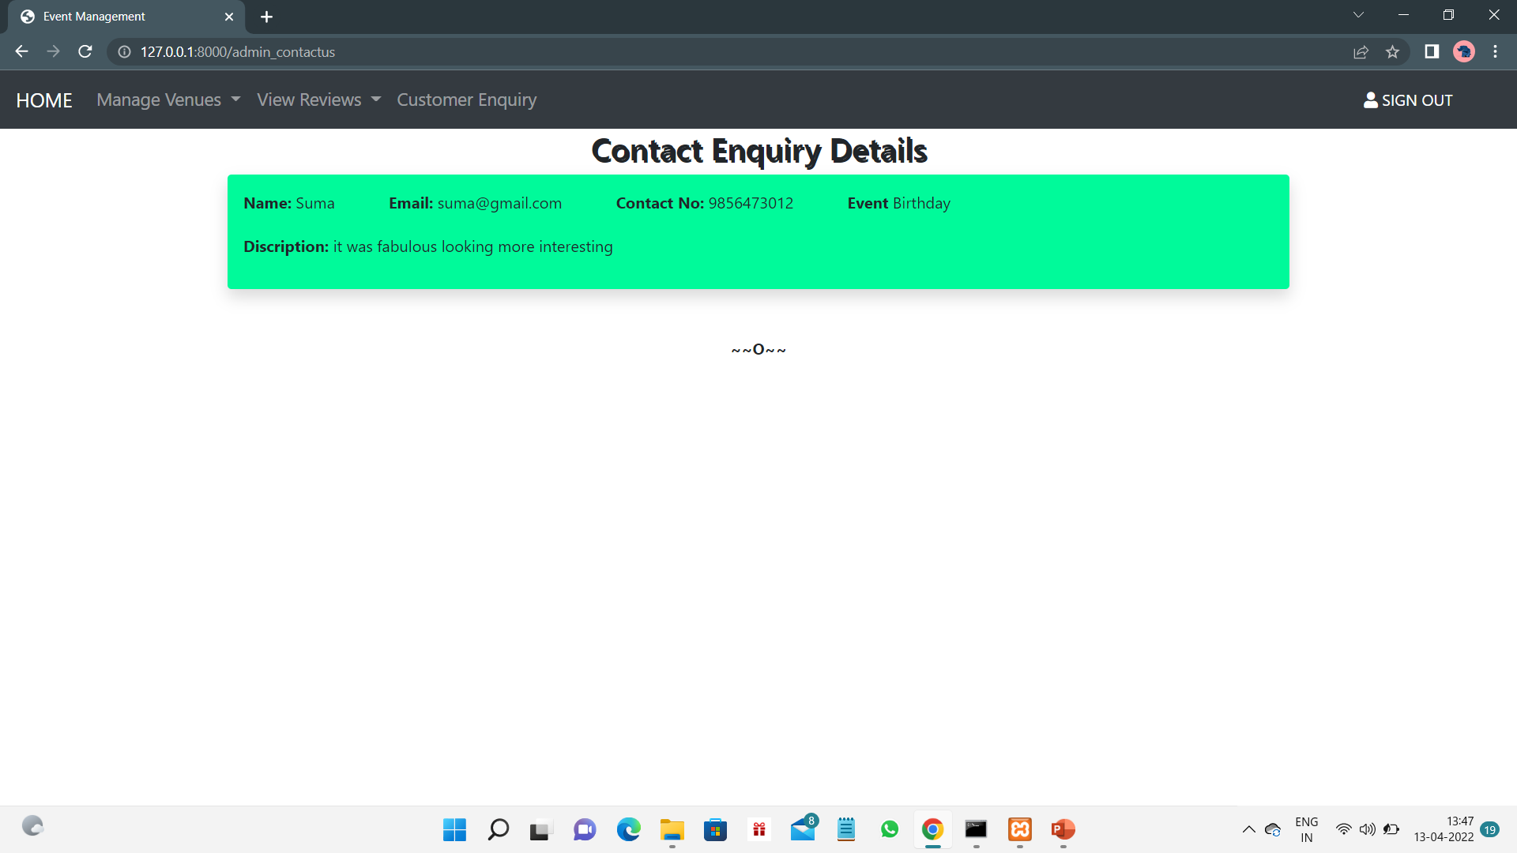
FEEDBACKS AND ENQUIRY LIST

Slide 11
THANK YOU

